Slide 1
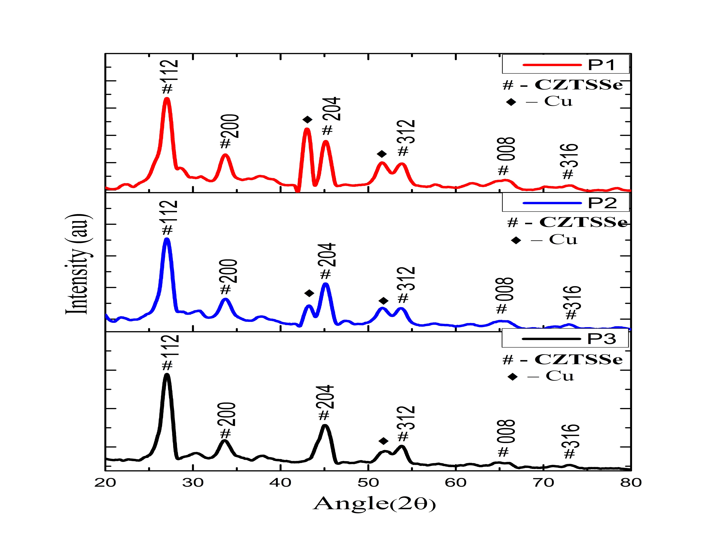
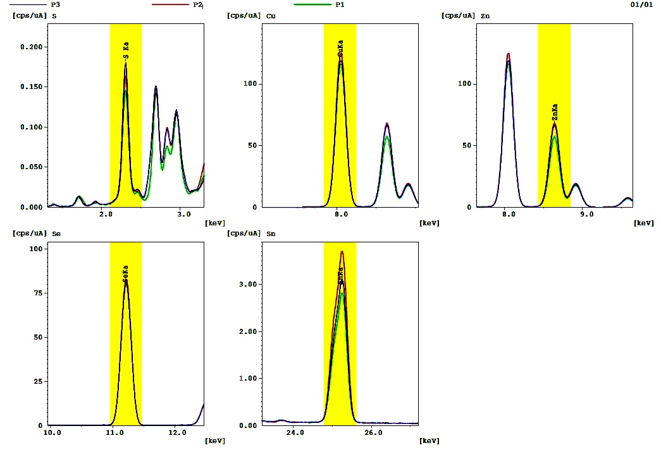
Paper ID -
ISSMD - 2024
Department of Physics, University of Kashmrir Srinagar India.
Title of the Paper
XXXX Kumarª, YYYYY, ZZZZ, KKKK^{a, *}
ª Author’s Affiliation
^{b} Author’s Affiliation
*Corresponding Author’s mail id
Heading-1
Heading-2
technique.
Thin CZTSSe film was deposited on glass, glass/ Mo, glass/ ITO and Si Se atmosphere in the graphite box.
450 °C and was hold for 20 min.
The.
Successfull removal of binary phases was done by etching it with HCl (0.5 Mby for 10 and 30 seconds respectively.
to relatively high abundance of Cu, Zn and Sn compared to In, Ga and Te.
It absorption coefficient greater than 10⁴ cm-1.
Due devices.
The solar till date is 12.6 %.
CZTSSe can be,etc.
Heading-3
Heading-4
Heading-5
Sample Name | Cu/(Zn+Sn) | Zn/Sn | Se/S
Annealed (P1)
Etched with HCl(P2)
Etched with HCl & NH4OH(P3)
Heading-6
Sample Name | Angle(2θ) | FWHM | Crystallite Size( Å)
Annealed (P1)
Etched with HCl(P2)
Etched with HCl & NH4OH(P3)
Sample Name | Resistivity | Mobility | Carrier Conc. | Conductivity
Annealed (P1)
Etched with HCl(P2)
Etched with HCl & NH4OH(P3
Heading-7
Heading-8
Peak shifts towards right from angle (2θ) 27.035 to 27.065 and its crystallite size increases from 0.163 nm to 0.180 nm.
The intensity of Cu decreases after treatment with HCl.
Successfull deposition of CZTSSe film using screen printing.
The etching process has ben carried out using the solution of HCl
Acknowledgement
Notes:
<number>

